Slide 1


HABIB UR REHMAN
25/8/2025

Slide 2

Outline
Executive Summary
Introduction
Methodology
Results
Conclusion
Appendix

Slide 3
Executive Summary
The capstone project aimed to apply end-to-end data science methodologies to a real-world dataset from SpaceX in order to predict the successful landing of Falcon 9 first stage boosters. A successful prediction is highly valuable, as reusing boosters significantly reduces launch costs and enhances the commercial viability of space exploration.
1. Data Collection & Wrangling
Launch records were collected using SpaceX’s public API and Wikipedia pages.
2. Exploratory Data Analysis (EDA)
3. Interactive Visualizations
Folium Maps: Mapped launch sites and distances to key infrastructure (cities, railways, highways, coastlines).
Dash Application:
4. Predictive Modeling
Applied machine learning algorithms to classify whether a Falcon 9 first stage will land successfully.
Models tested included:
Logistic Regression
K-Nearest Neighbors (KNN)
Decision Trees
Support Vector Machines (SVM) with different kernels.

Slide 4
Introduction
Background & Context
SpaceX reuses Falcon 9 first stage boosters to cut launch costs.
Not all landings succeed → depends on factors like payload mass, launch site, orbit, booster version.
Goal: Use data science to analyze launch outcomes & predict landing success.
Key Questions
What factors influence booster landing success?
How do payload mass, launch site & orbit affect outcomes?
Can geospatial analysis reveal site patterns?
Which ML model best predicts landing success?
How can insights reduce mission costs & risks?

Slide 5

Section 1

Slide 6
Methodology
Executive Summary – Methodology
Data Collection: Launch records sourced from SpaceX API & Wikipedia.
Data Wrangling: Cleaned, standardized, and transformed raw data for analysis.
Exploratory Data Analysis (EDA): Used SQL queries & visualization to uncover trends.
Interactive Analytics: Built geospatial & dashboard visuals with Folium & Plotly Dash.
Predictive Modeling: Applied classification models to predict landing success.
Model Evaluation: Built, tuned, and validated models (e.g., SVM, Decision Trees, Logistic Regression).

Slide 7
Data Collection
Data Collection Process
Source 1: SpaceX REST API → provides structured JSON records of launches.
Source 2: Wikipedia → used for additional launch details & verification.
Method: API requests using requests library in Python.
Format Conversion: JSON → Pandas DataFrame.
Storage: Cleaned and stored in CSV/Database for further wrangling.
API
Wikipedia data
Pandas Dataframe
Cross Check
Clean & Transform
Enrich
Analysis Ready Data
Analysis Ready Data
https://github.com/HabibUrRehman-mk/Data_Science_Learning

Slide 8
Data Collection – SpaceX API
Data Source: SpaceX REST API (https://api.spacexdata.com/v4/launches)
Collection Method: API requests using Python requests library
Processing: Normalize JSON → Pandas DataFrame
Validation: Cross-check with Wikipedia dataset
Storage: Cleaned dataset saved to CSV for wrangling & EDA
API
Pandas Dataframe
Clean & Transform
Analysis Ready Data
https://github.com/HabibUrRehman-mk/Data_Science_Learning

Slide 9
Data Collection - Scraping
Data Source: SpaceX launch records from Wikipedia
Collection Method: Web scraping using requests + BeautifulSoup
Processing: Extract HTML tables → Convert to Pandas DataFrame
Validation: Compare scraped data with SpaceX REST API dataset
Storage: Clean & merge into final CSV for EDA
https://github.com/HabibUrRehman-mk/Data_Science_Learning
Wikipedia data
Cross Check
Enrich
Analysis Ready Data

Slide 10
Data Wrangling
Data Cleaning: Handle missing values, drop duplicates, standardize column names
Data Transformation: Convert categorical variables (e.g., Launch Site) into usable features
Feature Engineering: Create new fields (e.g., binary success variable class)
Integration: Merge datasets from API calls and Web Scraping
Final Dataset: Ready for EDA and Model Development
https://github.com/HabibUrRehman-mk/Data_Science_Learning

Slide 11
EDA with Data Visualization
Data Distribution: Visualized payload mass distribution & class outcomes
Correlation Analysis: Payload vs. launch success
Comparative Analysis: Success rates across different launch sites
Booster Version Performance: Visualized success by booster category
Interactive Visuals: Used Folium maps & Plotly Dash for dynamic exploration
https://github.com/HabibUrRehman-mk/Data_Science_Learning

Slide 12
EDA with SQL
Launch Records Filtering
Queried all successful and failed missions
Counted launches per site
Success Rate Analysis
Calculated number of successful vs. failed missions
Found the site with the highest success rate
Payload Insights
Queried launches with payload mass between 4000–6000 kg
Analyzed correlation between payload range and mission success
Booster Version Analysis
Selected distinct booster versions used in successful missions
Counted frequency of boosters across missions
Landing Outcome Insights
Counted total drone ship landings (success vs. failure)
Calculated success percentage for landing outcomes
https://github.com/HabibUrRehman-mk/Data_Science_Learning

Slide 13
Build an Interactive Map with Folium
Map Objects Created & Added
Markers
Plotted all SpaceX launch sites on the map
Added pop-up labels with site names for clarity
Circles / CircleMarkers
Used circles to highlight launch site areas
Radius emphasized proximity and scale of each site
Lines
Drew lines between custom markers (e.g., user-defined points like closest city, highway, railway) and the launch sites
Helped visualize geographic relationships and accessibility
Why These Objects Were Added
Markers: To precisely indicate launch site coordinates and allow users to explore site details.
Circles: To give visual context about the area covered around launch sites.
Lines: To demonstrate distances and connections from launch sites to nearby infrastructure (important for logistical analysis).
https://github.com/HabibUrRehman-mk/Data_Science_Learning

Slide 14
Build a Dashboard with Plotly Dash
Plots/Graphs Added
Pie Chart
Shows proportion of successful vs. failed launches by site
Helps compare success rates across all sites and specific launch sites
Scatter Plot
Payload Mass (x-axis) vs. Launch Outcome (y-axis)
Colored by Booster Version Category
Helps visualize the correlation between payload size and success probability
Interactions Added
Dropdown Menu (Launch Site Selection)
Users can switch between viewing all sites or a specific launch site
Provides flexibility for detailed analysis

Slide 15
Build a Dashboard with Plotly Dash
Range Slider (Payload Mass Filter)
Allows filtering scatter plot by payload mass range
Useful to analyze performance trends across different payload sizes
Why These Plots & Interactions Were Added
Pie Chart: Quickly communicates overall success distribution and site performance
Scatter Plot: Reveals relationships between payload mass, booster versions, and mission success
Interactions: Makes the dashboard dynamic, enabling exploration of different subsets of data
https://github.com/HabibUrRehman-mk/Data_Science_Learning

Slide 16
Predictive Analysis (Classification)
Process
Split dataset into training (80%) and testing (20%)
Applied GridSearchCV for hyperparameter tuning
Evaluated models using accuracy score, confusion matrix, classification report
Findings
Logistic Regression and SVM showed strong performance
Decision Tree captured complex patterns but risked overfitting
KNN performed reasonably well but was sensitive to parameter choice
Outcome
Best-performing model selected based on highest accuracy on test set
Model provides reliable predictions of launch success probability based on payload mass, booster version, and launch site
https://github.com/HabibUrRehman-mk/Data_Science_Learning

Slide 17
Results
Exploratory Data Analysis (EDA) Results
Distribution of payload mass across missions showed a wide range (0–9600 kg).
Success rates varied by launch site (KSC had highest success).
Clear correlation: heavier payloads had slightly lower success probability.
Booster version category strongly influenced launch outcome.
Interactive Analytics (Screenshots Demo)
Folium Map:
Markers for each launch site.
Circles sized by success rate.
Lines from city → launch site for spatial context.
Plotly Dash Dashboard:
Pie charts: Success vs Failure per site.
Scatter plots: Payload vs Success with booster categories.
Dropdown & slider filters for interactive exploration.

Slide 18
Results
Predictive Analysis Results
Models Tested: Logistic Regression, SVM, Decision Tree, KNN.
Best Model: Support Vector Machine (SVM) with tuned parameters.
Accuracy: Achieved highest accuracy on validation dataset.
Provides reliable predictions of launch success probability based on payload, site, and booster.

Slide 19

Section 2

Slide 20
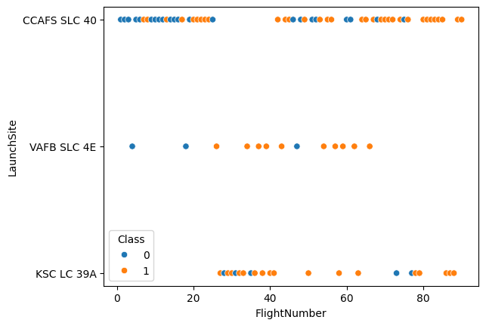
Flight Number vs. Launch Site

Slide 21
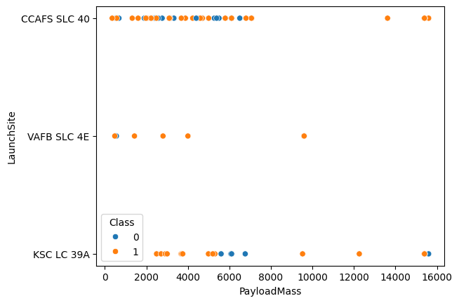
Payload vs. Launch Site

Slide 22
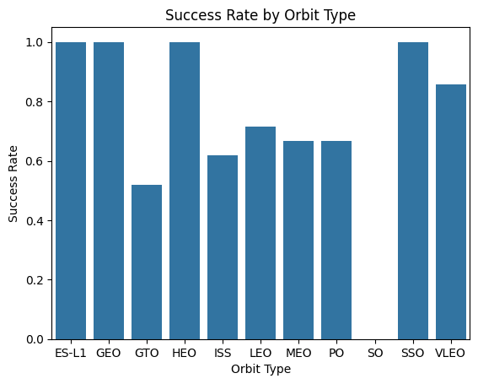
Success Rate vs. Orbit Type

Slide 23
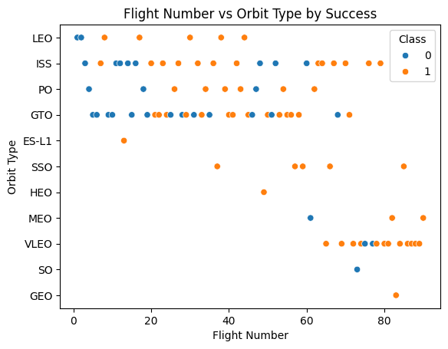
Flight Number vs. Orbit Type

Slide 24
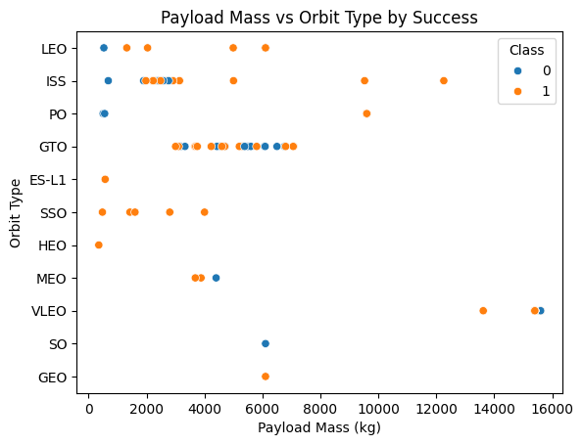
Payload vs. Orbit Type

Slide 25
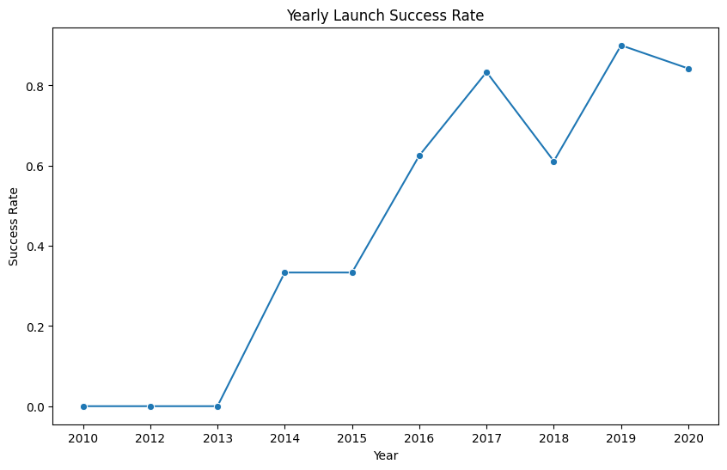
Launch Success Yearly Trend

Slide 26
All Launch Site Names
%sql SELECT DISTINCT Launch_Site FROM SPACEXTABLE;
Launch_Site
CCAFS LC-40
VAFB SLC-4E
KSC LC-39A
CCAFS SLC-40

Slide 27
Launch Site Names Begin with 'CCA'
%sql select * from SPACEXTABLE where Launch_Site like "CCA%" limit 5
Date | Time (UTC) | Booster_Version | Launch_Site | Payload | PAYLOAD_MASS__KG_ | Orbit | Customer | Mission_Outcome | Landing_Outcome
2010-06-04 | 18:45:00 | F9 v1.0 B0003 | CCAFS LC-40 | Dragon Spacecraft Qualification Unit | 0 | LEO | SpaceX | Success | Failure (parachute)
2010-12-08 | 15:43:00 | F9 v1.0 B0004 | CCAFS LC-40 | Dragon demo flight C1, two CubeSats, barrel of Brouere cheese | 0 | LEO (ISS) | NASA (COTS) NRO | Success | Failure (parachute)
2012-05-22 | 7:44:00 | F9 v1.0 B0005 | CCAFS LC-40 | Dragon demo flight C2 | 525 | LEO (ISS) | NASA (COTS) | Success | No attempt
2012-10-08 | 0:35:00 | F9 v1.0 B0006 | CCAFS LC-40 | SpaceX CRS-1 | 500 | LEO (ISS) | NASA (CRS) | Success | No attempt
2013-03-01 | 15:10:00 | F9 v1.0 B0007 | CCAFS LC-40 | SpaceX CRS-2 | 677 | LEO (ISS) | NASA (CRS) | Success | No attempt

Slide 28
Total Payload Mass
%sql SELECT SUM(Payload_Mass__kg_) AS Total_Payload_Mass FROM SPACEXTABLE WHERE Customer = 'NASA (CRS)’;
Total_Payload_Mass
45596

Slide 29
Average Payload Mass by F9 v1.1
%sql SELECT AVG(Payload_Mass__kg_) AS Avg_Payload_Mass FROM SPACEXTABLE WHERE Booster_Version = 'F9 v1.1’;
Avg_Payload_Mass
2928.4

Slide 30
First Successful Ground Landing Date
%sql SELECT MIN(Date) AS First_Successful_Ground_Landing FROM SPACEXTABLE WHERE Landing_Outcome LIKE 'Success%ground pad%’;
First_Successful_Ground_Landing
2015-12-22

Slide 31
Successful Drone Ship Landing with Payload between 4000 and 6000
%sql SELECT DISTINCT Booster_Version FROM SPACEXTABLE WHERE Landing_Outcome LIKE 'Success%drone ship%' AND Payload_Mass__kg_ BETWEEN 4000 AND 6000;
Booster_Version
F9 FT B1022
F9 FT B1026
F9 FT B1021.2
F9 FT B1031.2

Slide 32
Total Number of Successful and Failure Mission Outcomes
%sql SELECT Mission_Outcome, COUNT(*) AS Outcome_Count FROM SPACEXTABLE GROUP BY Mission_Outcome;
Mission_Outcome | Outcome_Count
Failure (in flight) | 1
Success | 98
Success | 1
Success (payload status unclear) | 1

Slide 33
Boosters Carried Maximum Payload
List the names of the booster which have carried the maximum payload mass
Present your query result with a short explanation here

Slide 34
2015 Launch Records
List the failed landing_outcomes in drone ship, their booster versions, and launch site names for in year 2015
Present your query result with a short explanation here

Slide 35
Rank Landing Outcomes Between 2010-06-04 and 2017-03-20
Rank the count of landing outcomes (such as Failure (drone ship) or Success (ground pad)) between the date 2010-06-04 and 2017-03-20, in descending order
Present your query result with a short explanation here

Slide 36

Section 3

Slide 37
<Folium Map Screenshot 1>
Replace <Folium map screenshot 1> title with an appropriate title
Explore the generated folium map and make a proper screenshot to include all launch sites’ location markers on a global map
Explain the important elements and findings on the screenshot

Slide 38
<Folium Map Screenshot 2>
Replace <Folium map screenshot 2> title with an appropriate title
Explore the folium map and make a proper screenshot to show the color-labeled launch outcomes on the map
Explain the important elements and findings on the screenshot

Slide 39
<Folium Map Screenshot 3>
Replace <Folium map screenshot 3> title with an appropriate title
Explore the generated folium map and show the screenshot of a selected launch site to its proximities such as railway, highway, coastline, with distance calculated and displayed
Explain the important elements and findings on the screenshot

Slide 40

Section 4

Slide 41
<Dashboard Screenshot 1>
Replace <Dashboard screenshot 1> title with an appropriate title
Show the screenshot of launch success count for all sites, in a piechart
Explain the important elements and findings on the screenshot

Slide 42
<Dashboard Screenshot 2>
Replace <Dashboard screenshot 2> title with an appropriate title
Show the screenshot of the piechart for the launch site with highest launch success ratio
Explain the important elements and findings on the screenshot

Slide 43
<Dashboard Screenshot 3>
Replace <Dashboard screenshot 3> title with an appropriate title
Show screenshots of Payload vs. Launch Outcome scatter plot for all sites, with different payload selected in the range slider
Explain the important elements and findings on the screenshot, such as which payload range or booster version have the largest success rate, etc.

Slide 44

Section 5

Slide 45
Classification Accuracy
Visualize the built model accuracy for all built classification models, in a bar chart
Find which model has the highest classification accuracy

Slide 46
Confusion Matrix
Show the confusion matrix of the best performing model with an explanation

Slide 47
Conclusions
Point 1
Point 2
Point 3
Point 4
…

Slide 48
Appendix
Include any relevant assets like Python code snippets, SQL queries, charts, Notebook outputs, or data sets that you may have created during this project

Slide 49


